Slide 1
Welcome to Marketing Management
Dr. Cecilia Ruvalcaba
BUSI 107 Week 11, Day 2

Slide 2
Sport Technology Seminar
Focusing on Virtual Reality
APRIL 14TH 8:30 – 11:30AM
Special Guests Include:
STRIVR Labs – The leading virtual reality sports training system
VP of Products & Innovation from SAP – Super Bowl 50 Host Committee
(UC Ballroom)

Slide 3
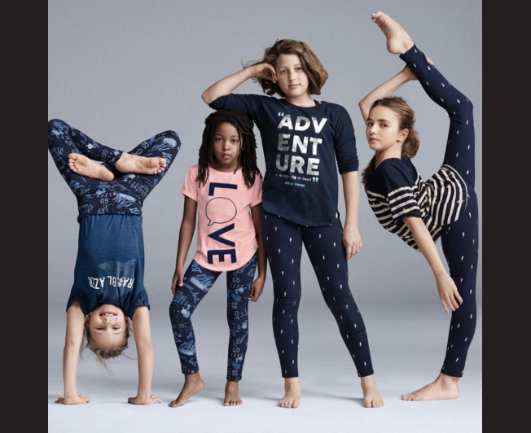

Notes:
Gap Has Apologized for This GapKids Ad, but Did It Need To?
http://www.adweek.com/adfreak/gap-has-apologized-gapkids-ad-did-it-really-need-170633

Slide 4
More Channel considerations B2b & global marketing channels

Slide 5

Characteristics of Business Markets
Producers Intermediaries Government Agencies Other Institutions
Fewer buyers, but larger purchases.
Buyers are geographically concentrated
Close supplier-customer relationships
Demand is:
Inelastic
Fluctuating
Derived

Slide 6
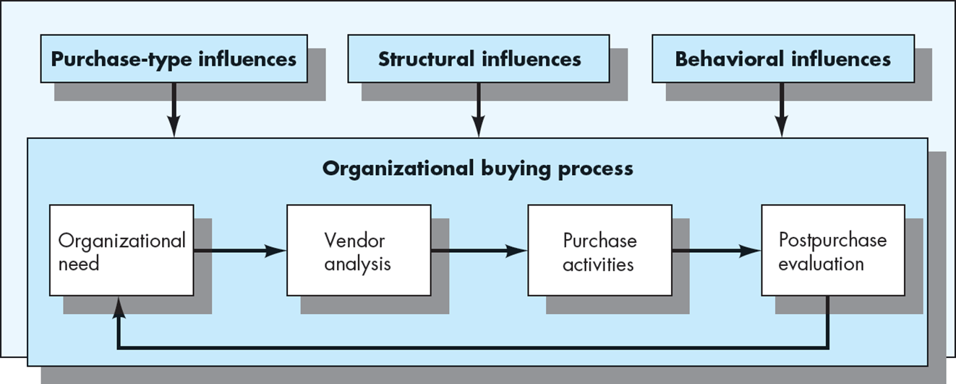
The Organizational Buying Process

Slide 7
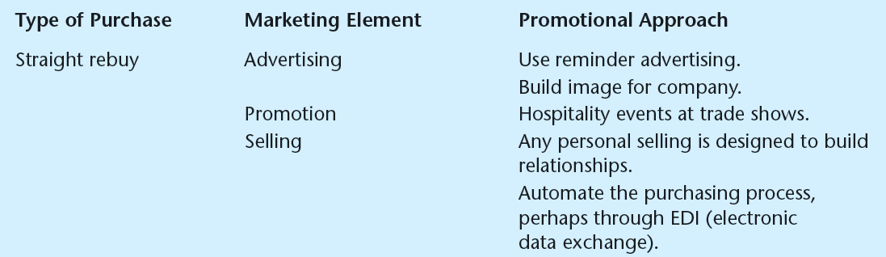

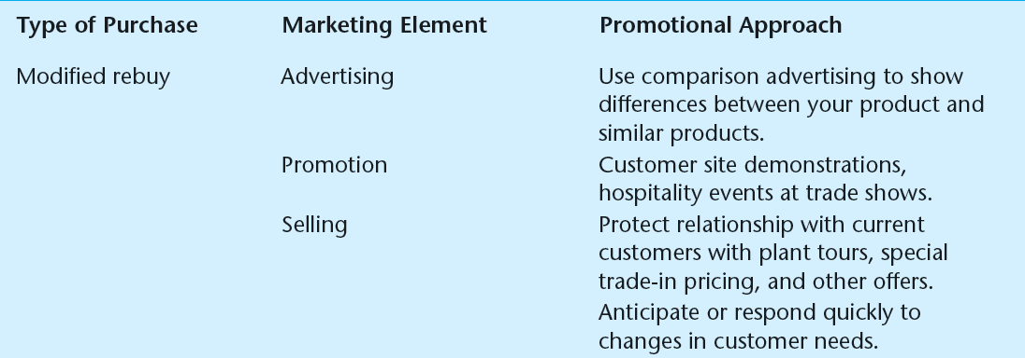

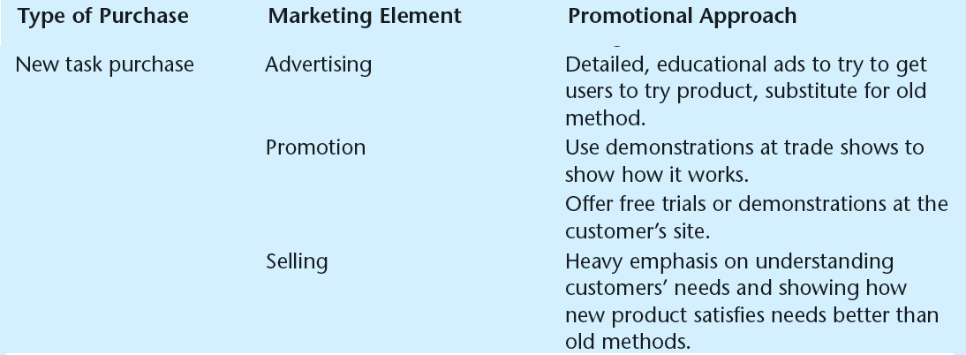
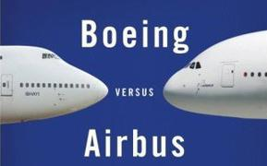
Purchase-Type
Influencers

Slide 8
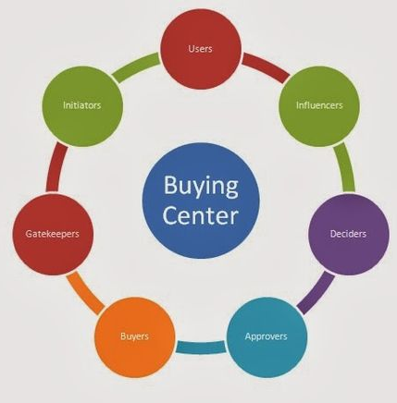
Structural & Behavioral Influences
Purchasing Roles
Organization-specific Factors
Orientation
Size
Centralization
Purchasing Policies and Procedures
Behavioral Influencers:
Personal Motives
Role Perceptions
Innovative- Weak commitment to expected norms of behavior
Adaptive- Moderate commitment
Lethargic- Strong commitment to traditionally accepted behavior

Slide 9
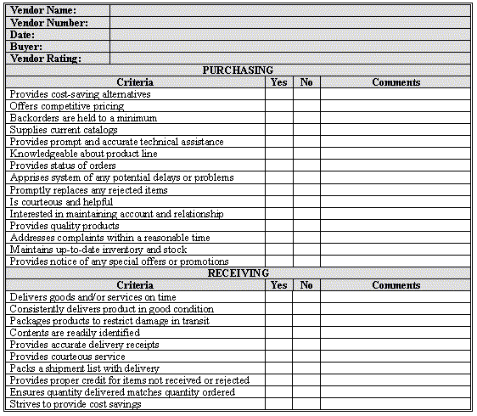
The Organizational buying process
ORGANIZATIONAL NEED -> VENDOR ANALYSIS -> PURCHASE -> EVALUATION
Notes:
Takata Loses Honda Over Faulty Airbag Scandal
http://www.wsj.com/video/takata-loses-honda-over-faulty-air-bag-scandal/59C6429A-8889-402F-A13E-230F51E60E42.html

Slide 10

Global Markets

Slide 11
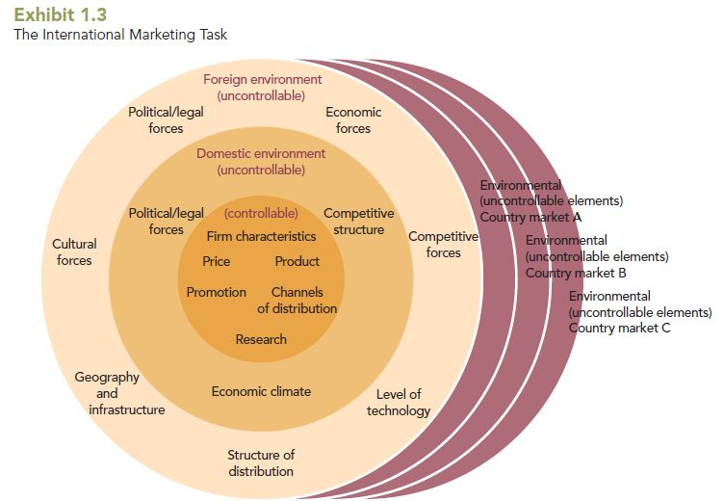
The International Marketing Task

Slide 12
Adaptation
Adaptation = Anticipate & Adjust
Obstacles
Self-Reference Criterion (SRC) is an unconscious reference to one’s own cultural values, experiences, and knowledge as a basis for decisions.
Ethnocentrism is the notion that people in one’s own company, culture, or country know best how to do things.

Slide 13
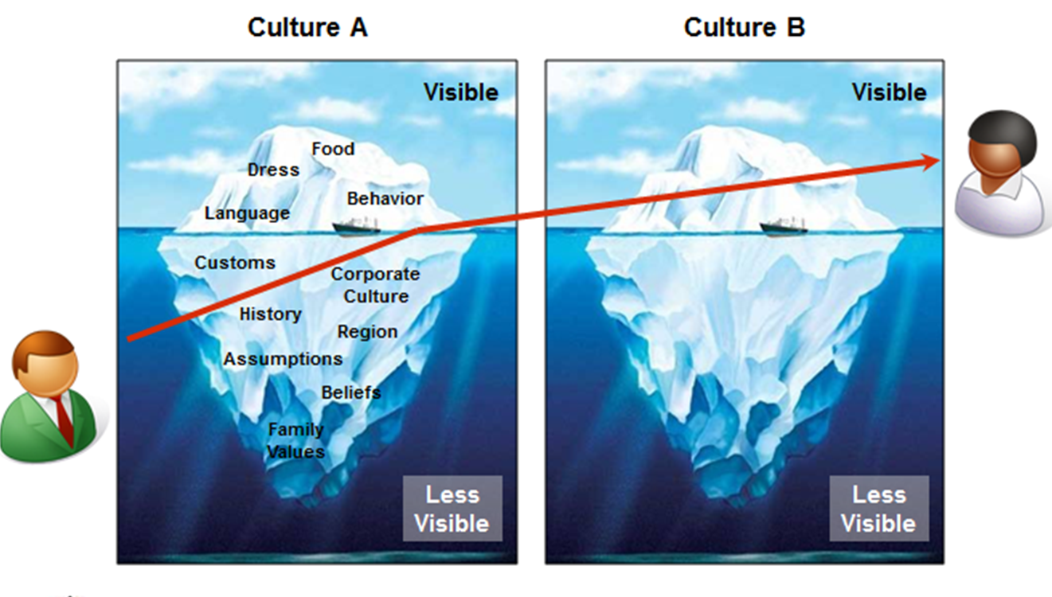

Slide 14


Take Away for Today
Buying: Organizational vs. Consumer
Know your demand influences
The Organizational Buying Process
What are the key influencers? Know who is playing the roles!
Global Marketing vs. Marketing… It’s in the Scope

Slide 15

Next Class
Chapter 7: Business-to-Business Marketing
Chapter 8: Global Marketing

